Slide 1
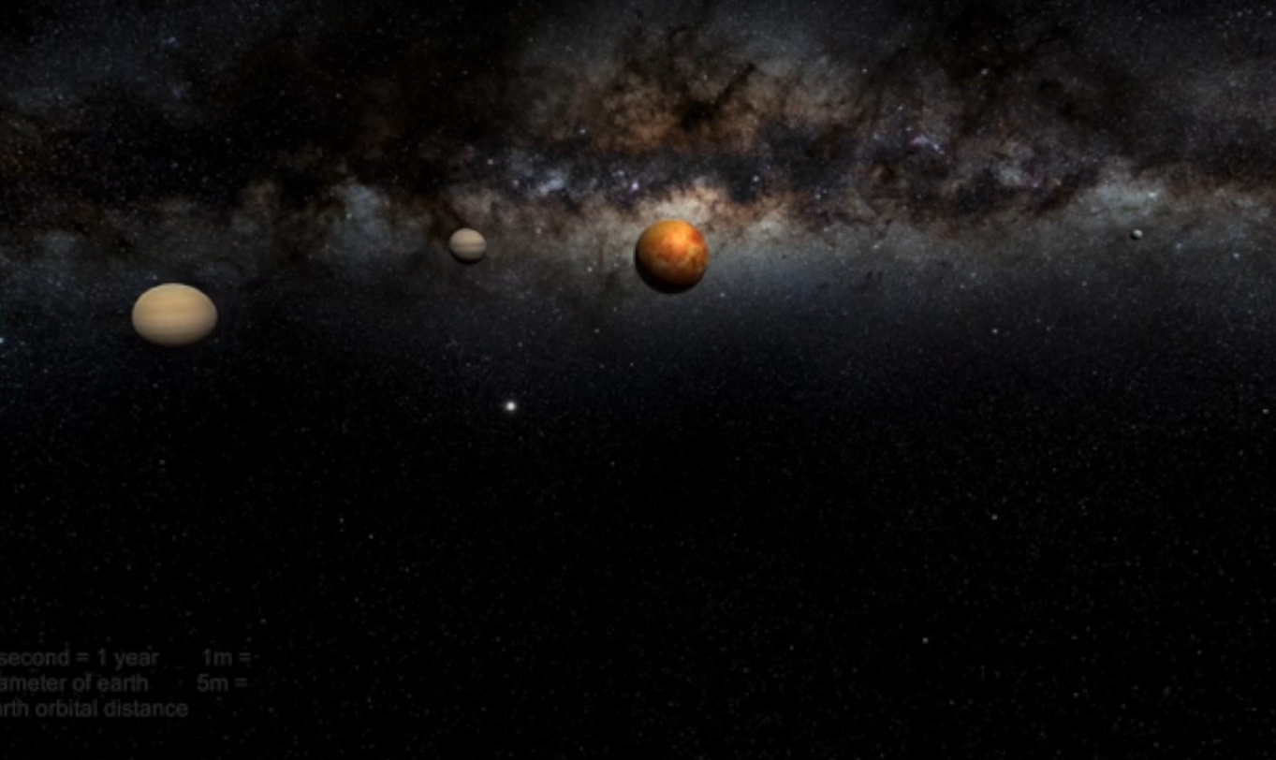
Solar Sounds
Sonify Space for Fun and Profit
Open Data for All
Amelia, Benjy, James, Jasmin, Serena, and Trevor

Slide 2
Open data is collected and interpreted in many ways. Could sound help give a feel for the data?
We looked at 3 different ways to create sound from open data collected by NASA and other Space Agencies
A scratch based program to interpret the sun’s surface as a series of frequencies
A Unity 3D model of the solar system with sounds giving information about planets’ orbits and distance with some solar wind information
3 tools to make a sonic Histogram using 52 notes to indicate the distribution of brightness on a solar image.

Slide 3

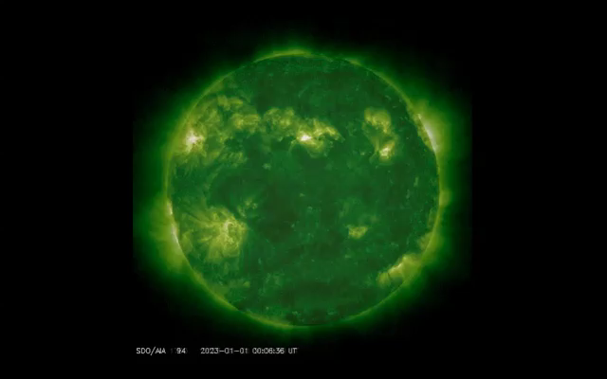
Scratch Code to sonify the sun’s various wavelenghts
Light spot = tinkling piano
Dark spots = grumbling Timpani
“Noise” = cymbal
Frequencies (Angstrom)
94 = green
131 = blue
171 = gold
193 = rust
211 = purple
304 = red
335 = blue
1600 = olive green
1700 = off salmon pink

Slide 4
Solar Simulation
I have been working on an accessible online tool which gives an solar experience both visually and, primarily, audibly.
Nasa planetary data has been translated into 3d by Unity to create the following features:
Scaled : 𝑥 seconds = 1 earth year | 1 m = diameter of earth | 5m = earth’s orbital distance | Sun not to scale
Trail distance is proportional to planet’s diameter
Audio volume is proportional to planet’s diameter
Audio clip is scaled to play clip twice per orbit
Time scale slows as you approach the sun
Sound clips made in Garageband to represent terrestrial and gas giant planets
Planet textures from solarsystemscope
Skybox from Unity Asset Store
Post processing
Looking forwards, I would like to add exosolar systems using the Nasa Exoplanet Archive and sonify solar flares data using H3LloVis and the Unity Particle system.

Slide 5

Unity 3D

Slide 6
Sonify the sun python tool suite
Tool to download data set as png
Tool to create histogram of png to a csv
Tool to turn csv to sound

Slide 7
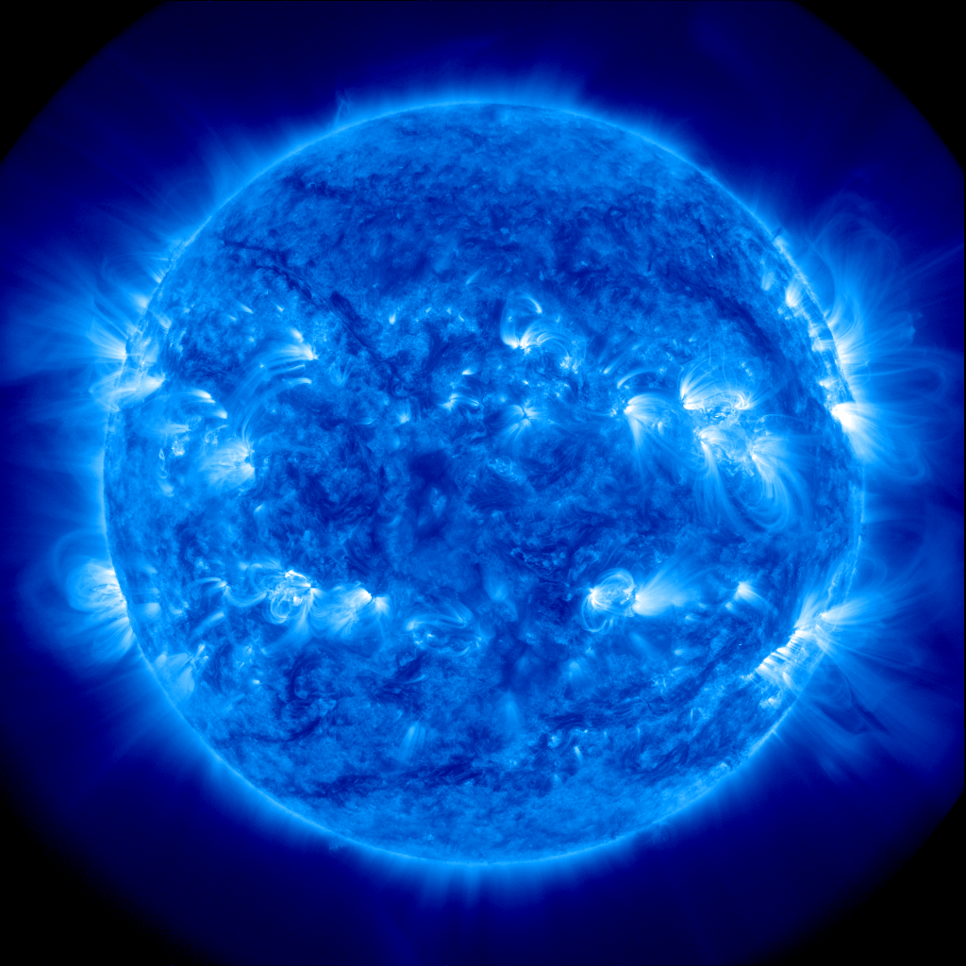
Sun song

